Slide 1










Typical Guides Fall Short
No book prepares you for the moment you realize your child’s milestones don’t match the page.
Notes:
No typical guidebook prepares you for the moment you realize your child’s milestones don’t match the page.

Slide 2
Meet Emma
When Emma was born, everything seemed fine.
Notes:
When Emma was born, everything seemed fine.

Slide 3






Meet Emma
When Emma was born, everything seemed fine.
As months passed, she wasn’t reaching milestones.
Parents felt worried and lost.
They learned Emma had Down syndrome.
The diagnosis brought clarity but no plan.
Birth
2m
4m
6m
8m
10m
Notes:
But as months passed, her parents noticed she wasn’t reaching milestones in typical parenting books.

Slide 4

Diagnosis -> Clarity but no Plan
Notes:
Eventually, they learned Emma had Down syndrome — a diagnosis that brought clarity, but no plan.

Slide 5

Emma’s Story Is Just One of Millions
Notes:
According to the 2022 National Survey of Children’s Health, approximately 10.7% about 7.8 million, of U.S. children ages 0–17 receive developmental special services.

Slide 6
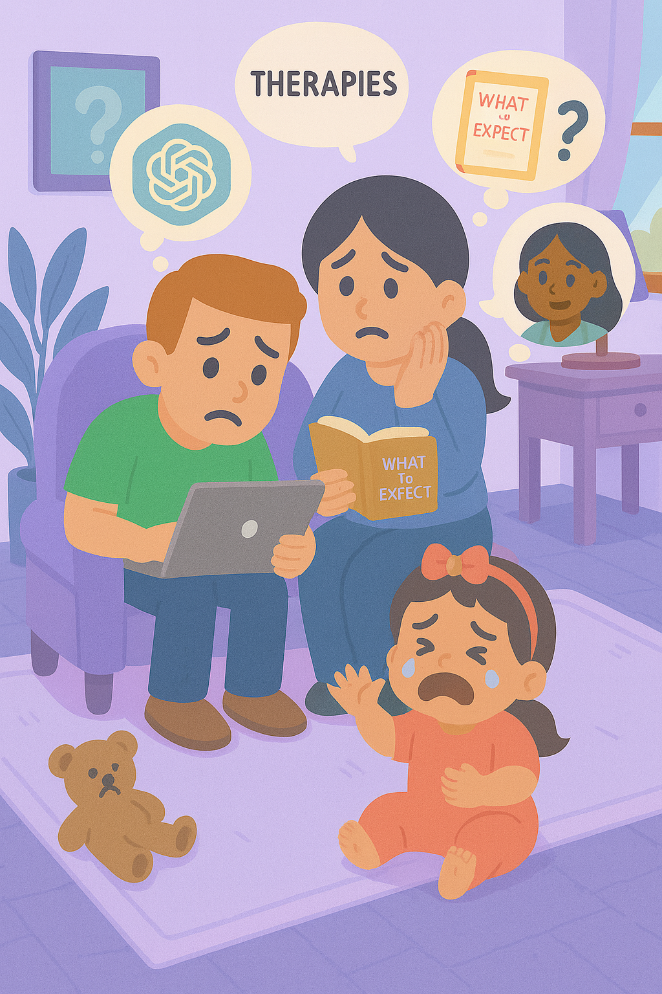
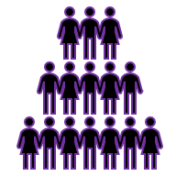
A Name, But NO Plan
MiLLIONS OF FAMILIES
Routines are hard to follow
and support often feels out of reach.
Guidance is fragmented
Notes:
These families face similar challenges, struggling with fragmented information and limited guidance and support.

Slide 7

That’s why we built Genex
Notes:
That’s why we built Genex. Genetics made practical.

Slide 8



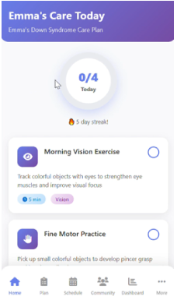





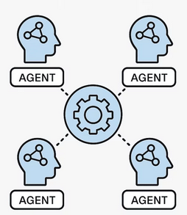

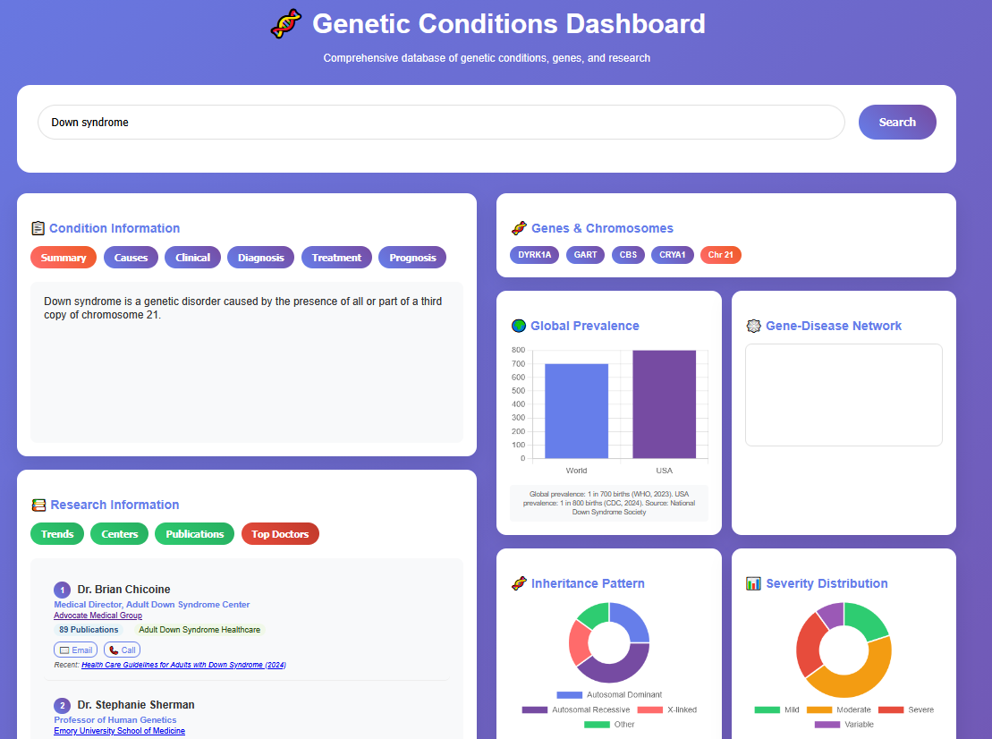


Genex – Technology
An AI care framework that learns with every family
Genex Core AI
Knowledge Graphs
Notes:
Genex is an AI-powered platform that unifies genetic and clinical data into one intelligent system. At its core lies a biomedical knowledge graph, enabling personalized insights through the Genex App and Dashboard

Slide 9
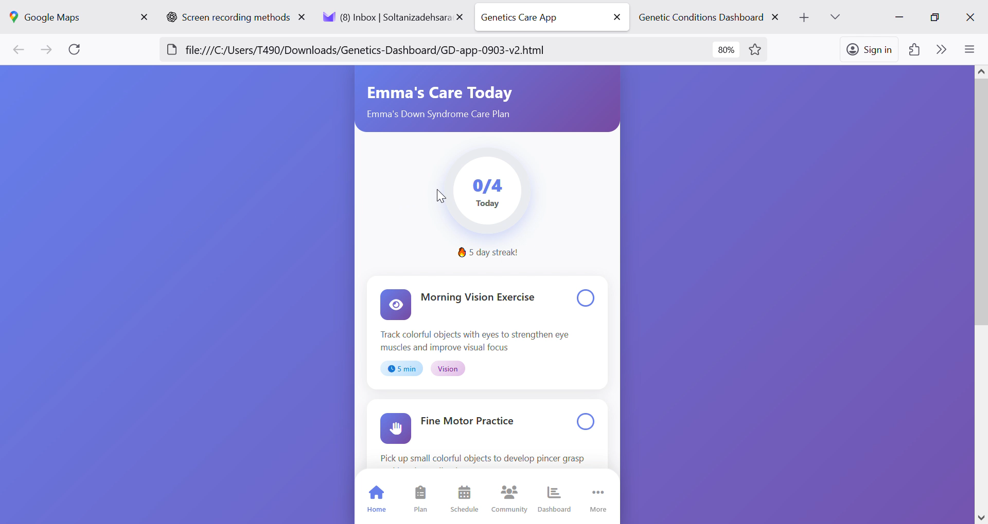
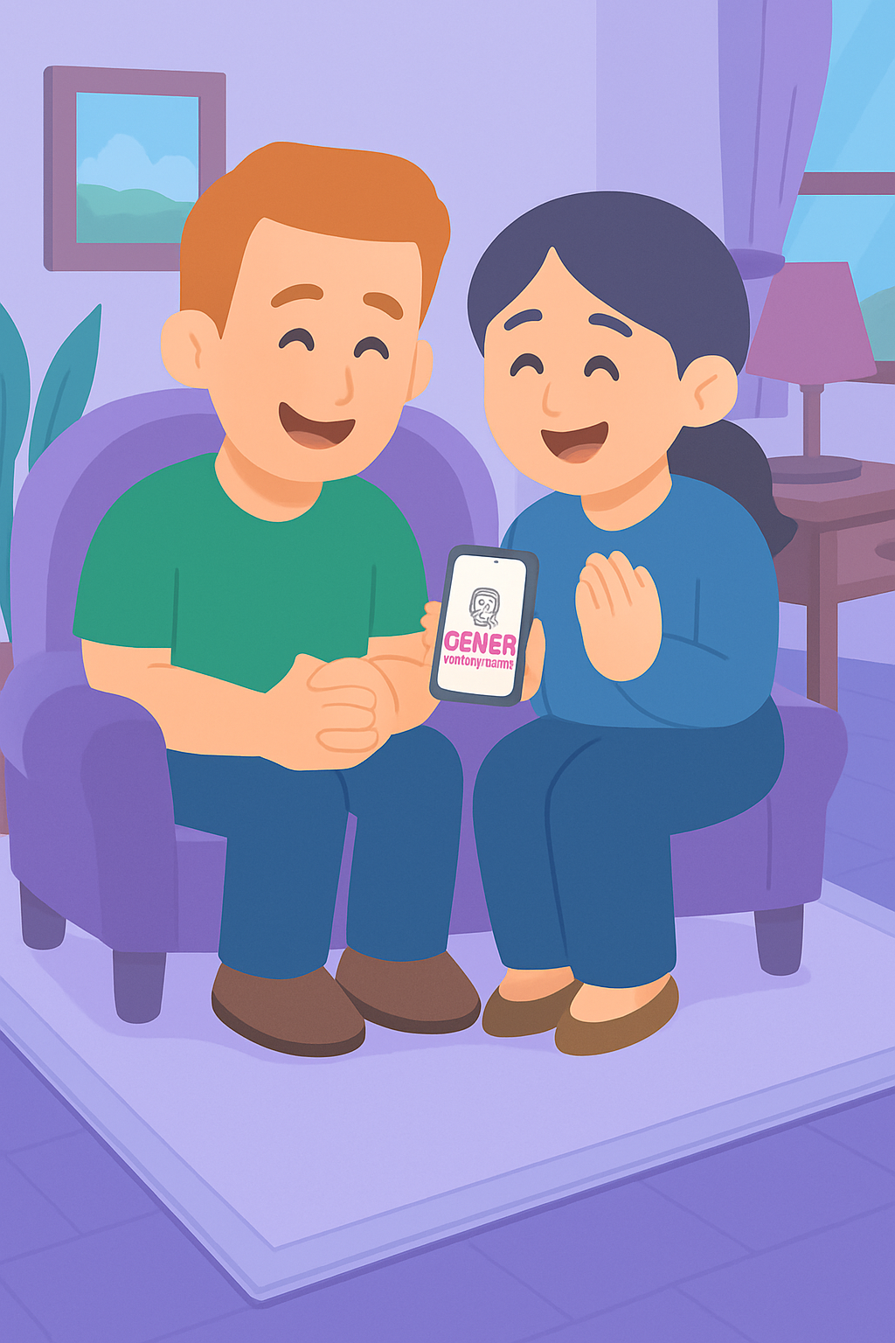
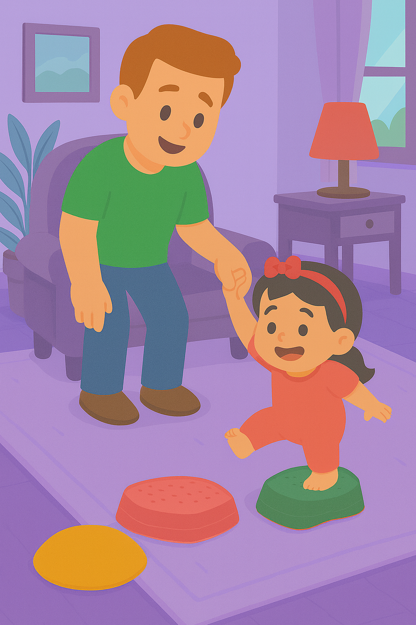
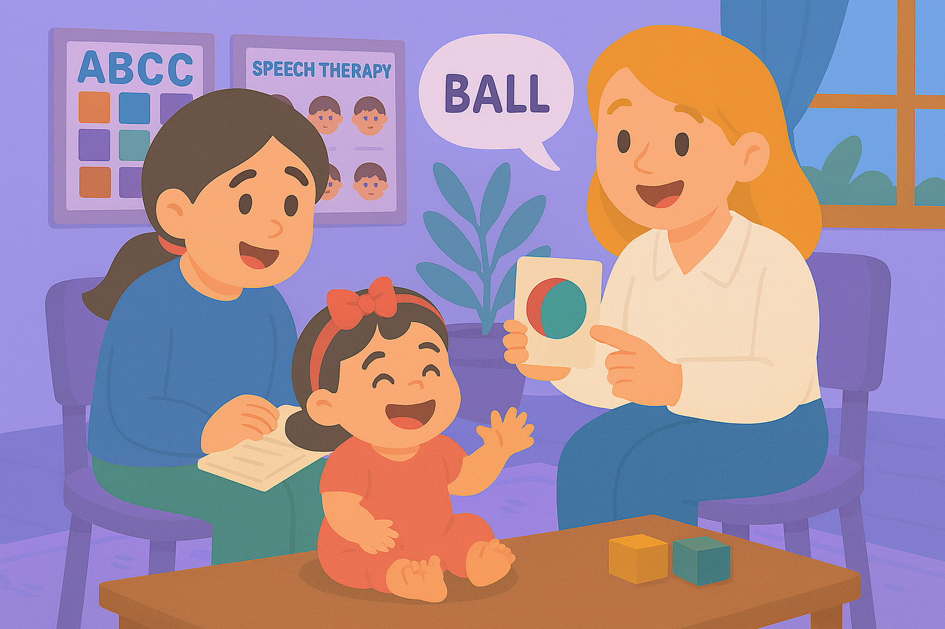
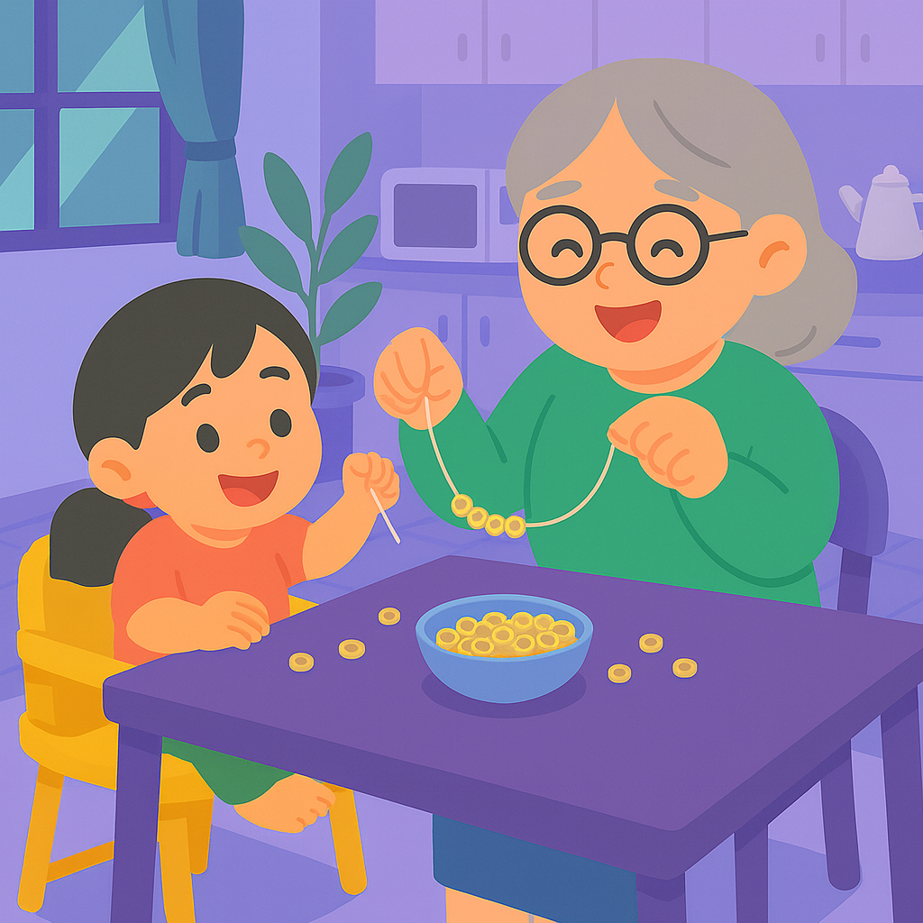
Introducing Genex – App
Care plans
Curated daily 5–10 min activities
Reminders
Progress tracking
A supportive community
Multilingual & Free
Notes:
The app offers tailored care plans, 5–10-minute daily activities, progress tracking, and a multilingual, supportive community—free for families.

Slide 10
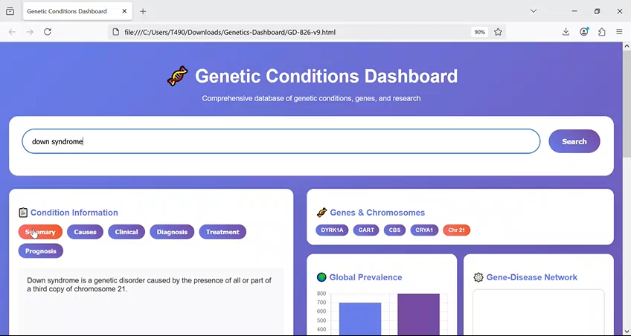


Introducing Genex – Dashboard
Offers:
Confidence-labeled info
At a glance visuals
Research lens
Helps:
Families understand better
Know what to ask
Providers give feedback.
Notes:
Instead of searching endlessly on Google or ChatGPT, Genex dashboard gives parents and clinicians one trusted hub with confidence-labeled information and visuals.

Slide 11



GeneX
Genetics Made Practical
Together we make care:
Simpler
Smarter
Supportive
Notes:
Together, we make care simpler, smarter and supportive. GeneX , Genetics Made Practical.

Slide 12
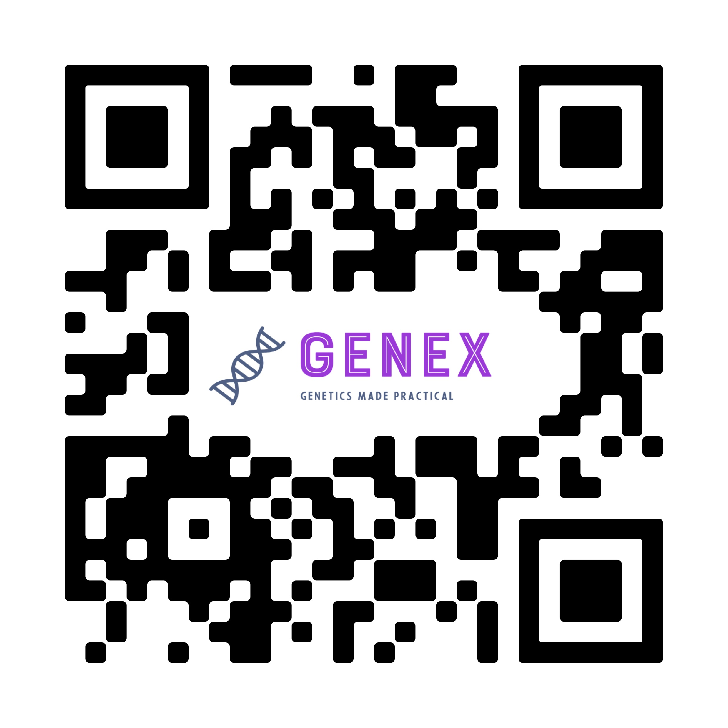
Scan the QR code.
Join Emma’s family, and explore our free app today.
Notes:
Scan the QR code, join Emma’s family, and explore our free app today.

